Slide 1
Should a judge engage in activities concerning the Rule of law even when they fall outside of their judicial activities?
MEDEL MEETING
SOFIA, BULGARIA
15 – 17 November 2018
Professor Hans Petter Graver, University of Oslo

Slide 2
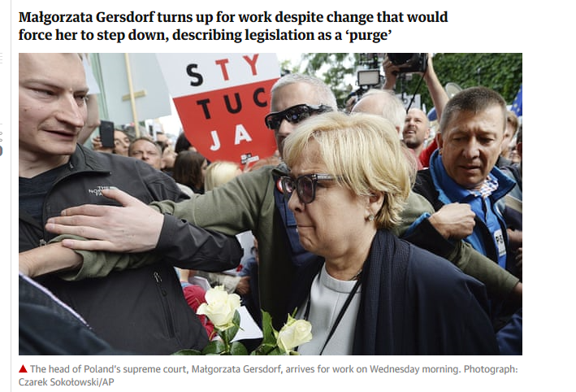
Małgorzata Gersdorf: «The judges of Poland cannot keep quiet»
22 December 2017: Letter to the citizens of Poland
4 July 2018: Publically turned up for work
20 July 2018: Lecture in Karlsruhe, Germany

Slide 3
Norwegian Supreme Court 1940
14 December 1940: Letter to Reichskommissar on judicial review
6 December 1940: Regulation lowering the pension age of judges. Reply from Reichskommissar with prohibition against judicial review
9 December 1940: Letter to minister of judges protesting against the application of the regulation on the judiciary
18 December 1940: Resignation of the Supreme Court judges

Slide 4
When should a judge engage?
A judge has freedom of speech, but should exercise restraint
Fidelity to law and separation of powers
The disinterested and impersonal judge
Judgements are the expressions of the judge, the person behind is immaterial

Slide 5
The state of exception: When the rule of law is under attack
The Rule of law:
Rule by law, not by arbitrary fiat
All equal under the law
The autonomy of law and independent courts
The protection of rights

Slide 6
Different types of judicial engagement
Political statements outside of the bench
Assertion of jurisdiction and judicial review
Statements in legal opinions
Judging contra legem

Slide 7
When to speak out
To protect their role, judges should keep a low public profile, but:
Illegal attacks against individual judges
The Belgian judges and their Jewish colleagues
Systemic weaknesses
Budget and finances
System of appointment, advances, dismissal and discipline
Exploitation of systemic weaknesses to undermine judicial independence

Slide 8
Assertion of Jurisdiction
The “Dual State” is the most common form for undermining the Rule of law
The Dual State (Ernst Fraenkel): The Normative State and the Executive State, The Executive State determines the limits of the Normative State:
The judges should protect their final say in determining the limits of politics and state power

Slide 9
Statements in legal opinions
The law is the law, but it may be unfair or unreasonable
US sentencing law:
Although precedent forecloses Marion Hungerford's Eighth Amendment challenge to 18 U.S.C. § 92 under which she received almost all of her 159-year term of imprisonment, it cannot be left unsaid how irrational, inhumane, and absurd the sentence in this case is, and moreover, how this particular sentence is a predictable by-product of the cruel and unjust mandatory minimum sentencing scheme adopted by Congress. (Concurring statement of judge Reinhardt)

Slide 10
Judging contra legem
A ‘law’ that would extricate itself from the essential requirement of justice, namely, the equal treatment of equals. It thereby lacks completely the very nature of law; it is not merely flawed law, but rather no law at all.
Gustav Radbruch (1879-1949)

Slide 11
An alternative view
A judge, whether positioned by personal conviction on the left, center, or right of the political spectrum, who feels free to ignore the oath of office when compliance with it conflicts with his or her own credo, is no hero. Such conduct is bereft of integrity and is a self indulgent abuse of judicial power. There are only two honest courses open to a judge in such a situation: Either resign or comply with the oath of office.
South African Judges to the Truth and Reconciliation Committee

Slide 12
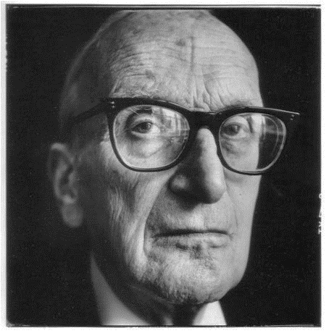
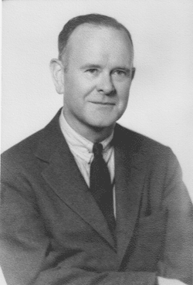
Can the immoral be law?
Lon Fuller (1902-1978): What contradicts «the inner morality of law is not law
H.L.H. Hart (1907-1992): Law and morality are separate
HLA Hart (1957) «Positivism and the separation of law and morals», Harvard Law Review, Vol. 71, s. 593–629 og LL Fuller (1957) «Positivism and fidelity to law – a reply to Professor Hart», Harvard Law Review, Vol. 71 s. 630–672.

Slide 13
Conclusions
The judicial role requires restraint and loyalty to the legislation
The dilemmas arise when the legislative and executive powers attack the rule of law
Judges could and should speak out when the judicial role is undermined
Judges should as far as possible protect the rule of law, and remember their personal moral duties. The law is no moral exoneration for the judge

