Slide 1
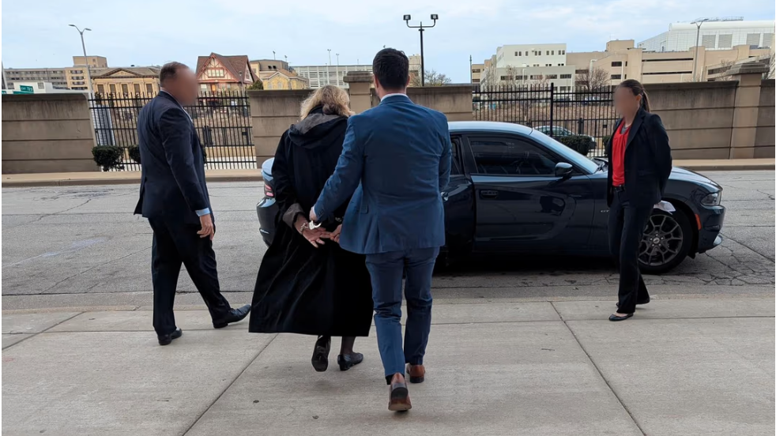
UNDER PRESSURE: THE CHALLENGE OF JUDICIAL INDEPENDENCE
Judge Hannah Dugan handcuffed by FBI leaving the courthouse in Milwaukee, Wisconsin
Notes:
* Presentere kort utviklingen i Ungarn, Polen og USA
* Se på fellestrekk
* Se på hva dommere kan gjøre med utgangspunkt i erfaringene fra Polen
* Til slutt spørsmålet: Kan det skje hos oss

Slide 2

Democracy in decline, and the judiciary is an important target
V-dem 2024: Liberal democacy the least common form of governance
Rule of law in decline 7 years in a row
Checks on the executive down in 59% of countries
Loss of fundamental rights in 63% countries
World Justice Project: regime change as a result of election is less likely in countries with low score on Rule of law

Slide 3
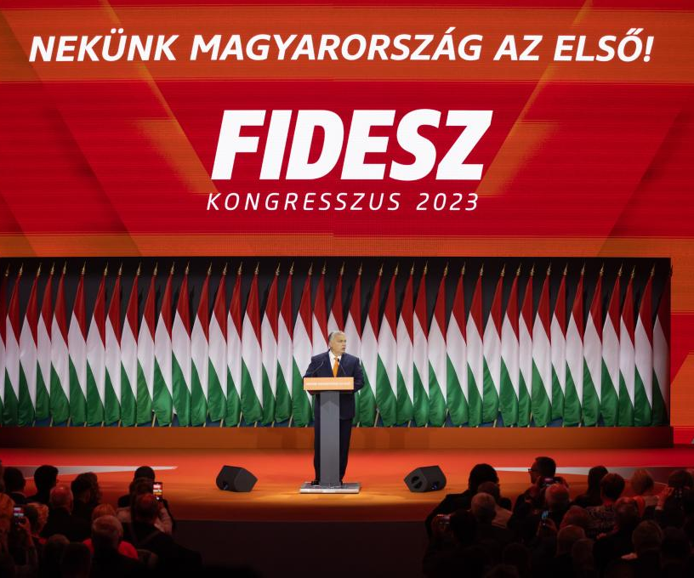
hungary – political context
Election 2010 and Fidesz’ victory (Victor Orban)
Fidesz and coalition partner gained supermajority
New constitution rushed through parliament without public consultation and debate (ammended 15 times since)
Systematic rule of exception: migrants, pandemic, war in Ukraine

Slide 4
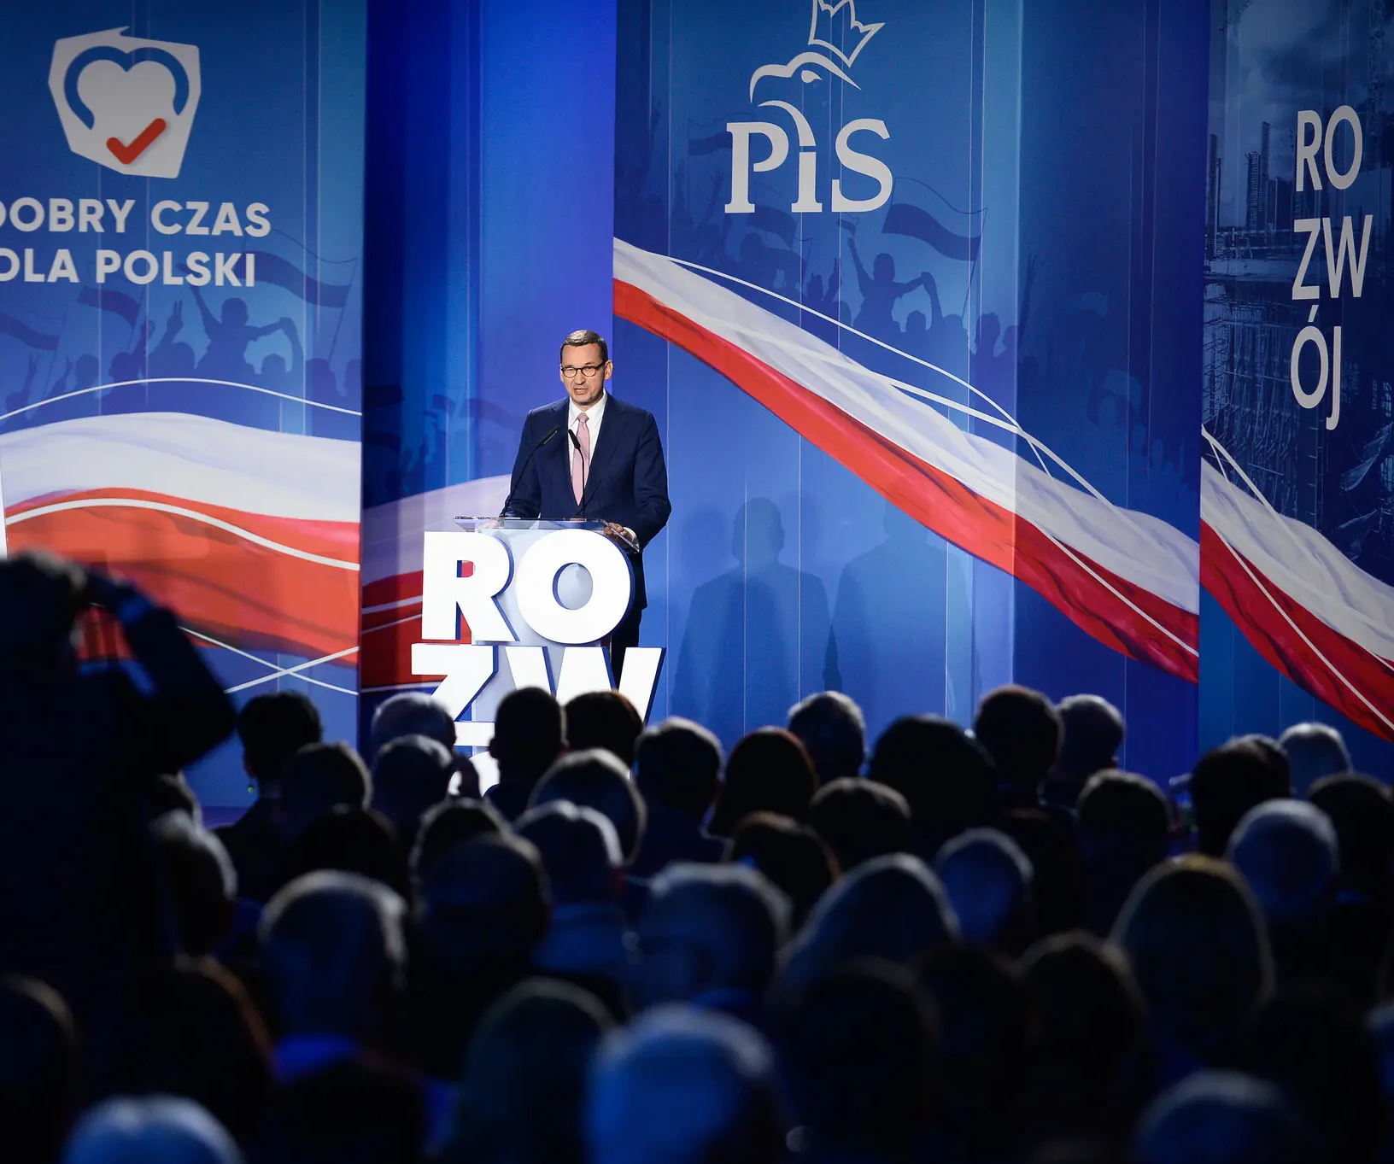
Polen – political context
Law and Justice Party (PiS) and 2015 election victory
With Hungary as role-model, but without supermajority
Kaczyński promised to reform the courts and prepared for this with public attacks on the courts and on individual judges

Slide 5
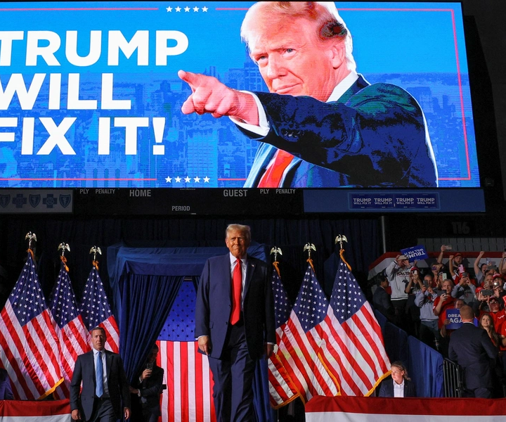
USA – political Context
Trump elected with majority in HoR and Senate
More than 130 president order first weeks to dismante «Deep State» and to regain power from the «radical liberal elite»
Apprehention and deportation of undocumentet immigrants, cut-downs of federal institutions, prohibition against DEI, sanctions, supression of political support to Hamas and Gaza
Over 600 cases before the courts

Slide 6
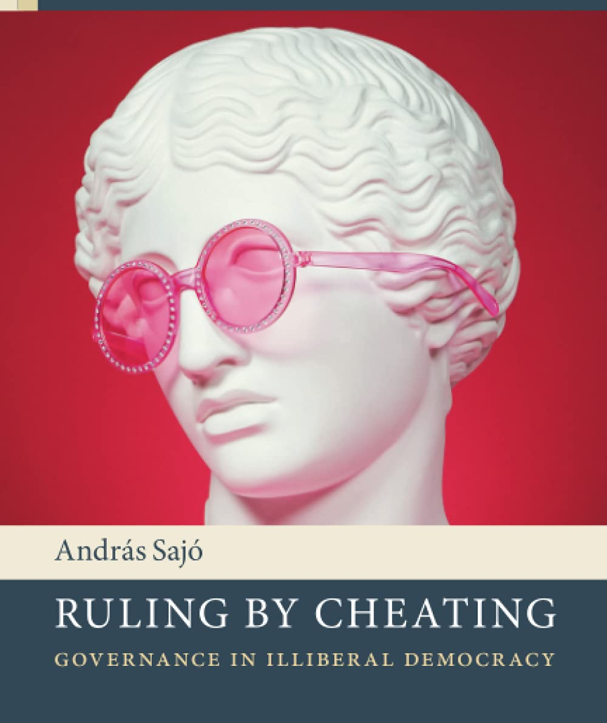
What is common?
Cynical autocrats willing to utilize every trick in the book
And to a certain extent openly defy the law
They have considerable public support
A polarized society
Many give support because they
feel overlooked
have low levels og trust
are angry and frustrated
are frightened and believe the authorities secure them

Slide 7
Autocratic techniques
Encapsuling the courts by establishing power centres out of judicial reach
The «dual state»
Targeting constitutional courts
Court packing and dismissal of judges
Changes in appointment proceedures
Legislation to limit and direct the courts
Most judges follow a positivist approach to legal authority
The potentinial conflict between legislation and the values underlying the rule of law
Control over appointment processes
Use of the media
Disciplinary proceedings
Loyal people to serve on Naional Councils of the Judiciary
Questioning of the integrity of the judiciary in general
Persectution of individual judges
Cooling effect of general investigations
Targeting specific action and rulings

Slide 8
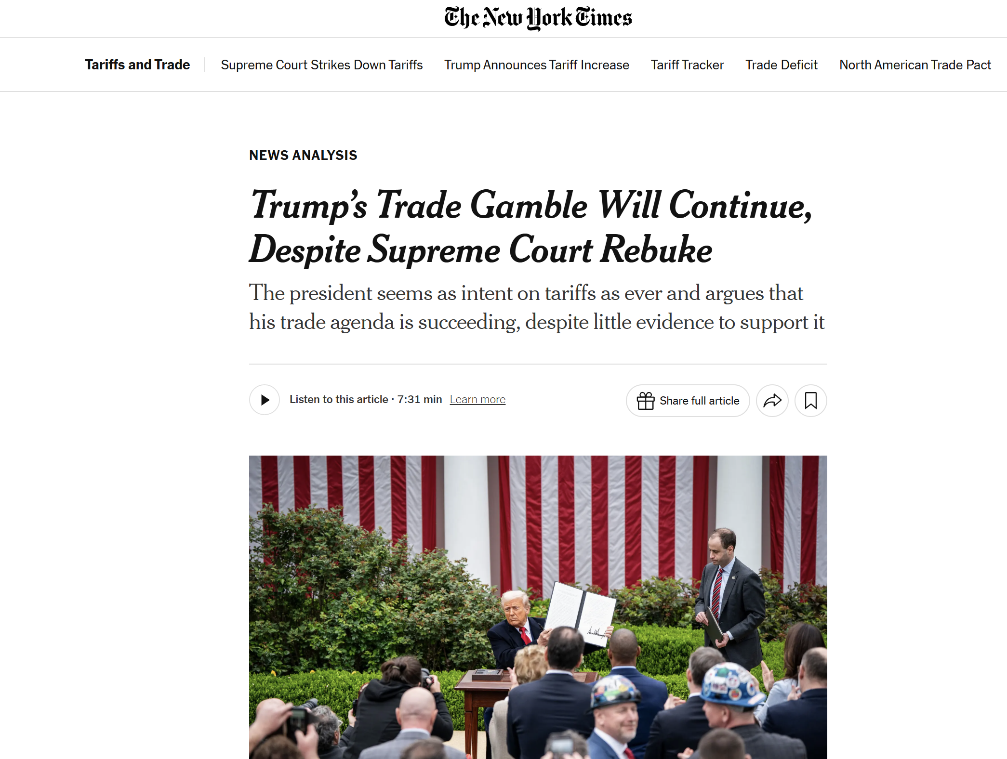
Undermining by neglect

Slide 9
How to distinguish between attacks and bona fide court reforms?
Apply a holistic approach – deliberate and systematic
Rule of law backsliding: “the process through which elected public authorities deliberately implement governmental blueprints which aim to systematically weaken, annihilate or capture internal checks on power with the view of dismantling the liberal democratic state and entrenching the long-term rule of the dominant party.” (Pech, L., and Scheppele, K. (2017))
ECtHR Grzęda v. Poland:
The Court notes that the whole sequence of events in Poland (see paragraphs 14-28 above) vividly demonstrates that successive judicial reforms were aimed at weakening judicial independence, starting with the grave irregularities in the election of judges of the Constitutional Court in December 2015, then, in particular, remodelling the NCJ and setting up new chambers in the Supreme Court, while extending the Minister of Justice’s control over the courts and increasing his role in matters of judicial discipline. (…) As a result of the successive reforms, the judiciary – an autonomous branch of State power – has been exposed to interference by the executive and legislative powers and thus substantially weakened.

